Slide 1
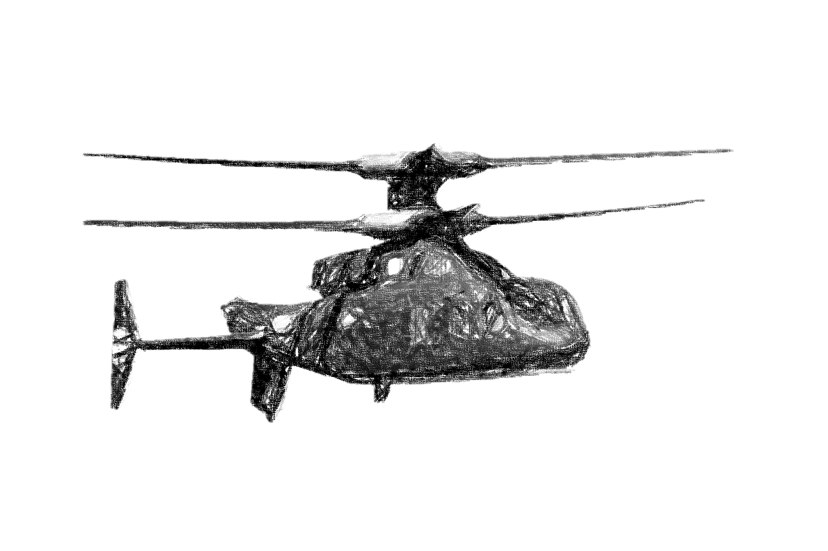

Literature Study Summary Meeting 20/12/2023
Y.J.E. Prencipe

Slide 2
Presentation Contents
1. What is already known about my topic and in which discipline is the topic discussed? 2. Which theories and concepts are used and discussed within the scope of my topic, and how are they defined? 3. How is my topic researched and what different research methods are there? 4. Which questions remain unanswered and what has yet to be researched

Slide 3
Presentation Contents
Design Aspects
Modelling
Control Architecture
Control Allocation
Handling Quality Assessment

Slide 4
Design Aspects

Slide 5
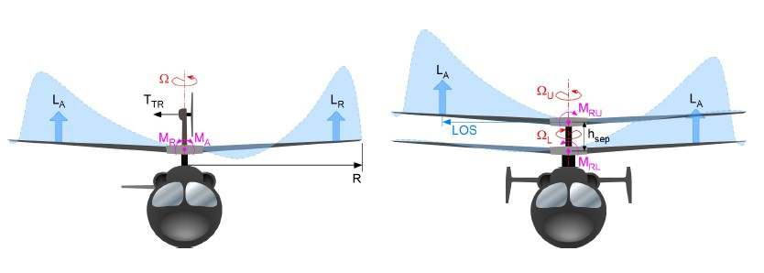

Advancing Blade Concept (ABC) Rotor
Lift-Offset (LOS): $LOS= \frac{M_{x}}{TR}$ using $Δ{θ_{1}}_{c}$

Slide 6
Control System Description

Slide 7
Modelling

Slide 8
Coaxial Rotor Modelling

Slide 9
Coaxial Rotor Modelling – Rotor Inflow

Slide 10
Coaxial Rotor Modelling – Rotor Interference Effects

Slide 11
Coaxial Rotor Modelling – Wake Contraction Effects

Slide 12
Coaxial Rotor Modelling – Blade Dynamics

Slide 13
Pusher Propeller Modelling

Slide 14
Airframe Modelling

Slide 15

Model Trimming
Additional trim target:
LOS using $Δ{θ_{1}}_{c}$ : $LOS=AV^{2}$ where A is a value such that LOS=0.2 @ 200kts [Ferguson 2015]

Slide 16
Control Architecture

Slide 17
PID Control

Slide 18
EMF Control

Slide 19
Pseudo-Control Hedging

Slide 20
Control Allocation

Slide 21
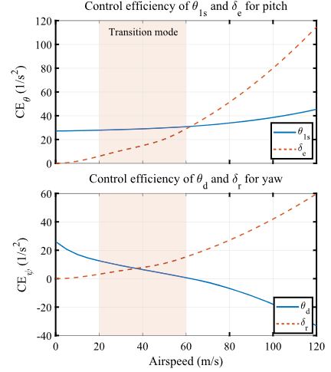
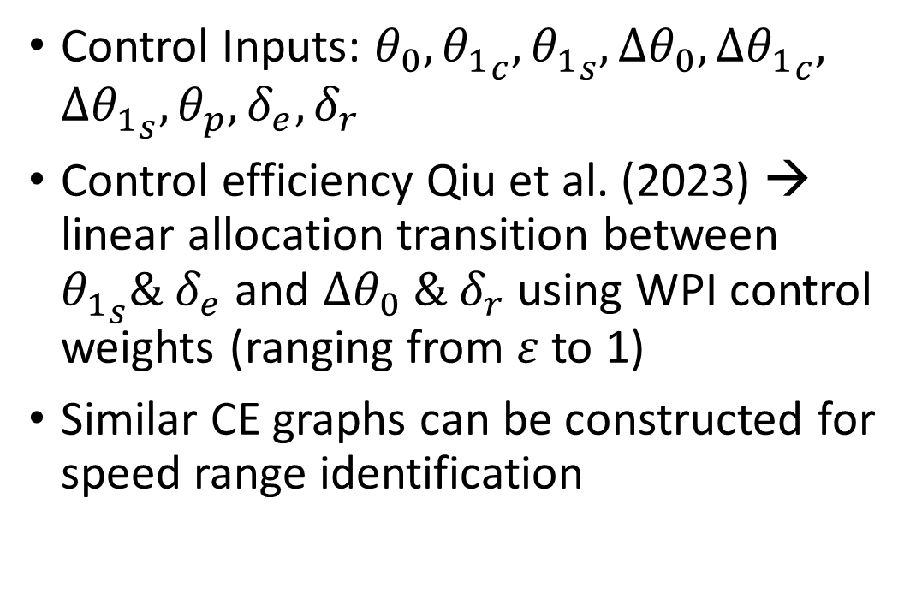
Control Allocation Techniques
Control Inputs: $θ_{0}, {θ_{1}}_{c},{θ_{1}}_{s},Δθ_{0},Δ{θ_{1}}_{c}, Δ{θ_{1}}_{s},θ_{p}, δ_{e},δ_{r}$
Control efficiency Qiu et al. (2023) → linear allocation transition between ${θ_{1}}_{s}\& δ_{e}$ and $Δθ_{0} \& δ_{r}$ using WPI control weights (ranging from $ε$ to 1)
Similar CE graphs can be constructed for speed range identification

Slide 22
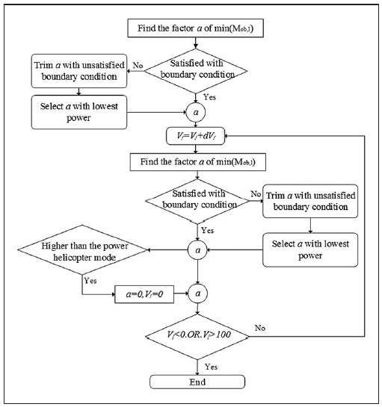
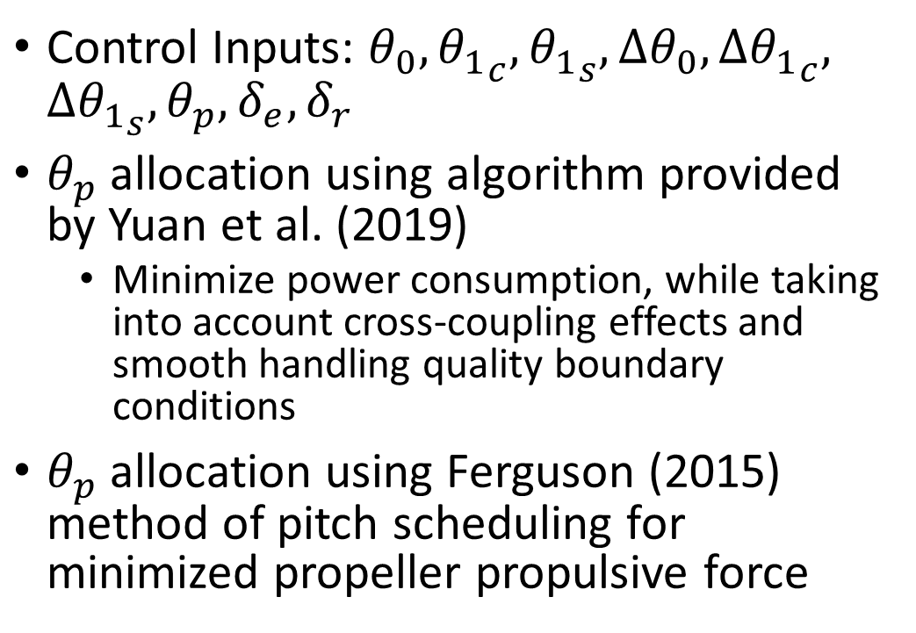
Control Allocation Techniques
Control Inputs: $θ_{0}, {θ_{1}}_{c},{θ_{1}}_{s},Δθ_{0},Δ{θ_{1}}_{c}, Δ{θ_{1}}_{s},θ_{p}, δ_{e},δ_{r}$
$θ_{p}$ allocation using algorithm provided by Yuan et al. (2019)
Minimize power consumption, while taking into account cross-coupling effects and smooth handling quality boundary conditions
$θ_{p}$ allocation using Ferguson (2015) method of pitch scheduling for minimized propeller propulsive force

Slide 23
Control Allocation Implementation Considerations

Slide 24
Handling Quality Assessment

Slide 25
Objective Handling Quality Criteria

Slide 26
Subjective Handling Quality Criteria

Slide 27
End of Presentation.
Ynias J.E. Prencipe

